Slide 1


Multilevel models
Dr Andi Fugard (they/them)
Intermediate Quantitative Social Research
10 Feb 2020
a.fugard@bbk.ac.uk

Slide 2
Today
We will cover the last new idea of the module: random effects
It may help to know that residuals are an example random effect

Slide 3
The plan for this eve
We started the module with linear regression
for normally distributed data
and saw how it generalises to other distributions for
binary (yes/no) & count data
This week: we will generalise the residuals

Slide 4
So far…
Linear model (regression)
lm(outcome ~ predictors, data = dat)
Generalised linear model (GLM)
glm(outcome ~ predictors, data = dat, family = binomial)
glm(outcome ~ predictors, data = dat, family = poisson)
glm(outcome ~ predictors, data = dat, family = quasipoisson)

Slide 5
Preview of this week’s new command
Linear model (regression)
lm(outcome ~ predictors, data = dat)
Linear mixed-effect model (LMM)
library(lme4)
lmer(outcome ~ predictors + (predictors | group), data = dat)

Slide 6

Multilevel data

Slide 7

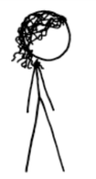










Students are in classrooms

Slide 8
Classrooms are in schools

Slide 9
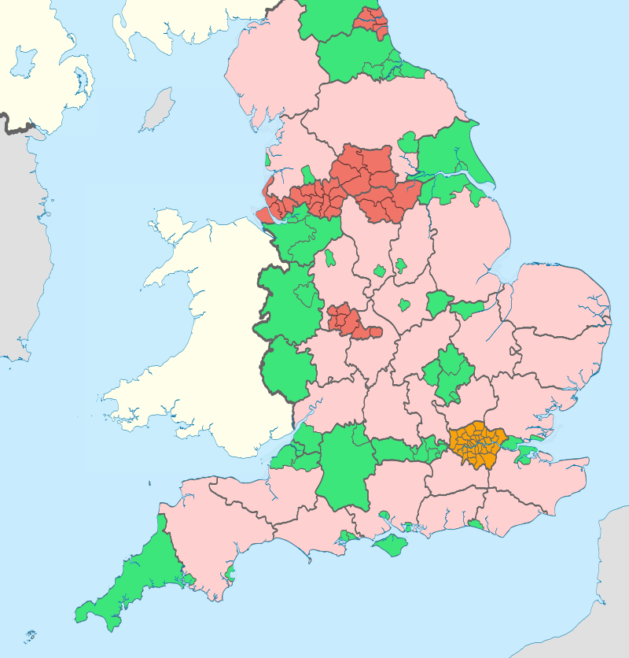

Slide 10
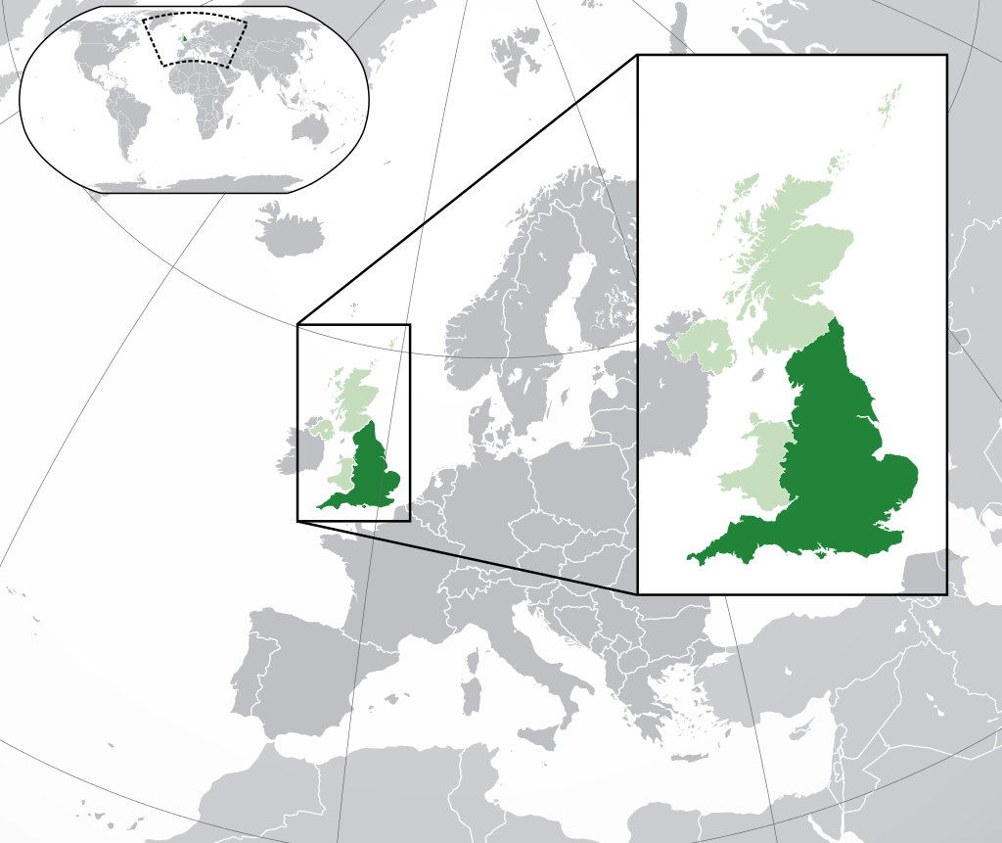

Slide 11
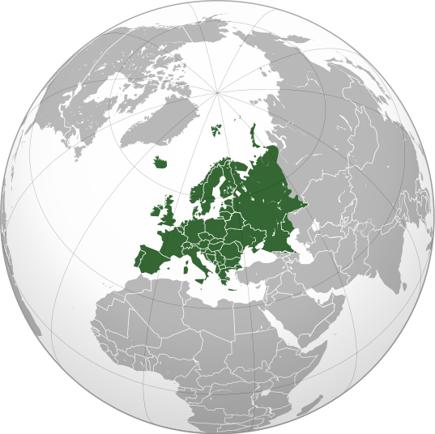

Slide 12


Each student can also be tracked over time (another level is “within participant”)
2015
2016
2017

Slide 13
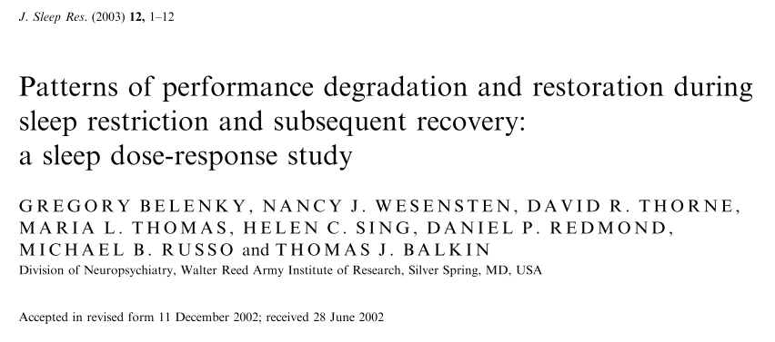

Slide 14
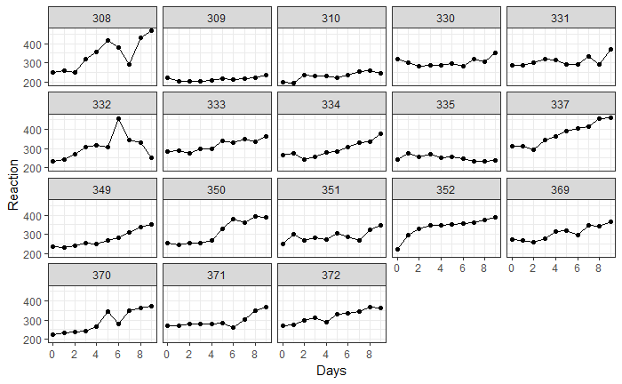

Slide 15
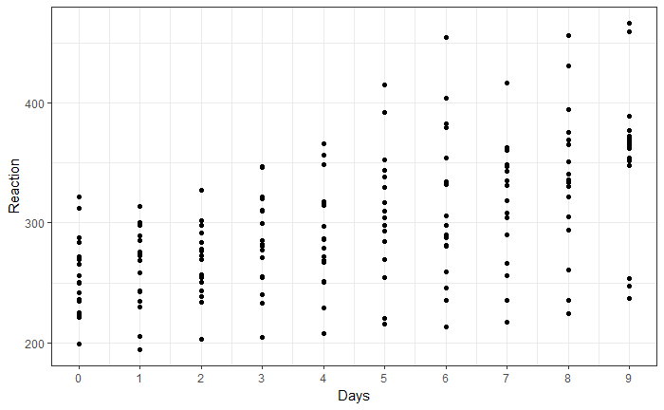

Slide 16
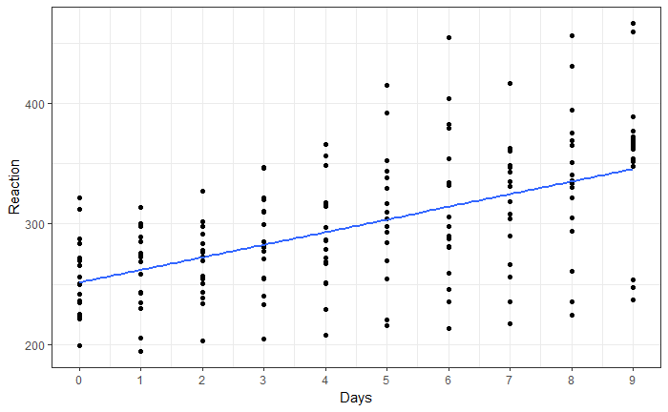
You could just use linear regression…

Slide 17
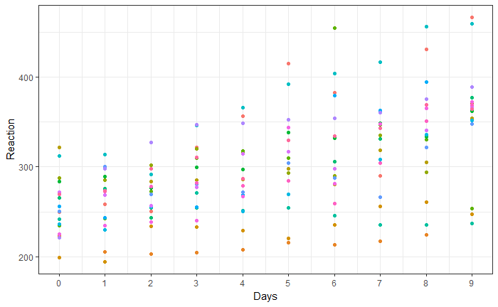
But that doesn’t “know” about the structure of the data

Slide 18
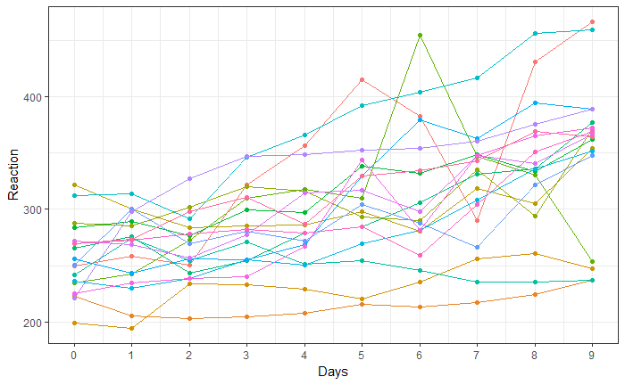

Slide 19
Why not just fit a separate regression model for each participant?

Slide 20
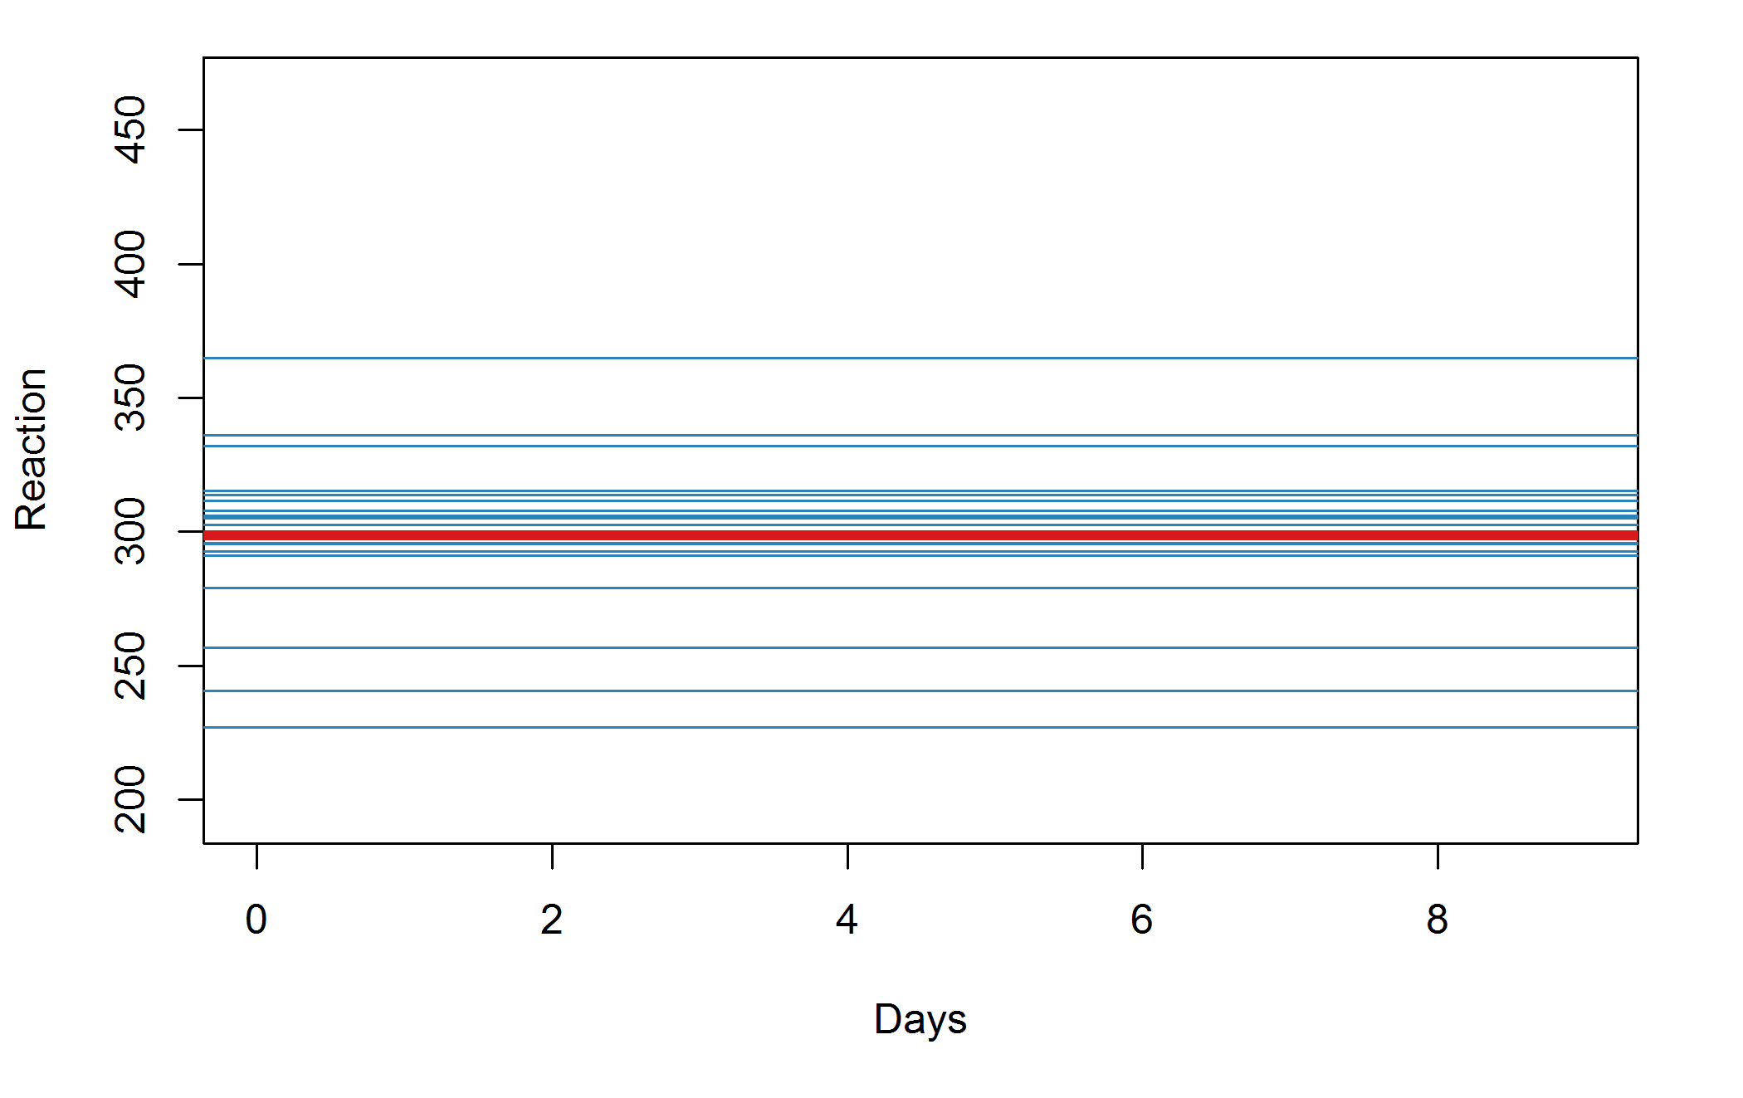
Our favourite baseline model

Slide 21
Average intercept

Slide 22
Intercept varies by participant

Slide 23
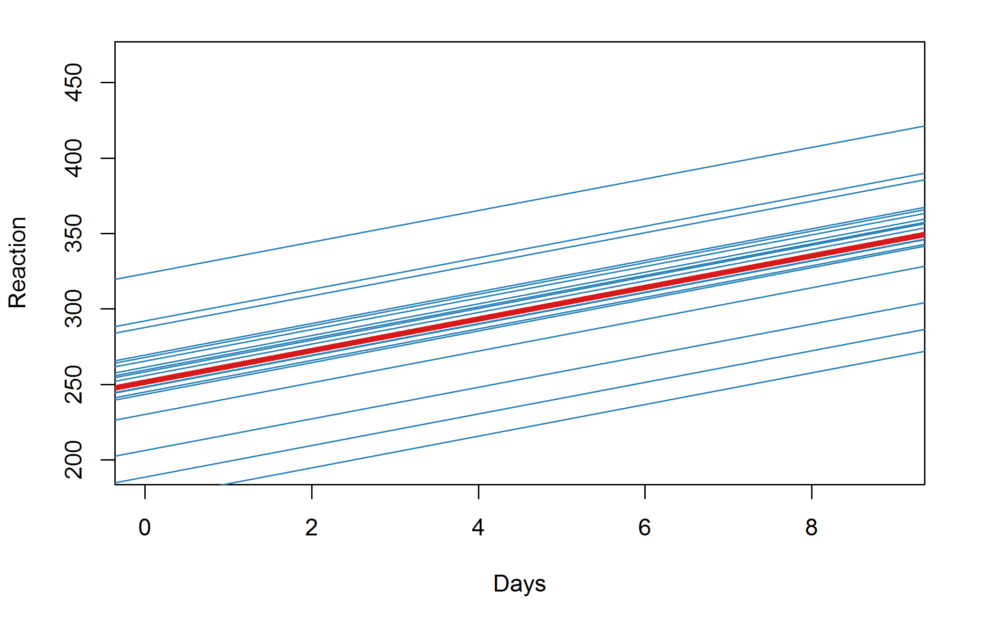
Less silly model

Slide 24
Average slope (slower reactions over time)

Slide 25
Intercept (still) varies by participant

Slide 26
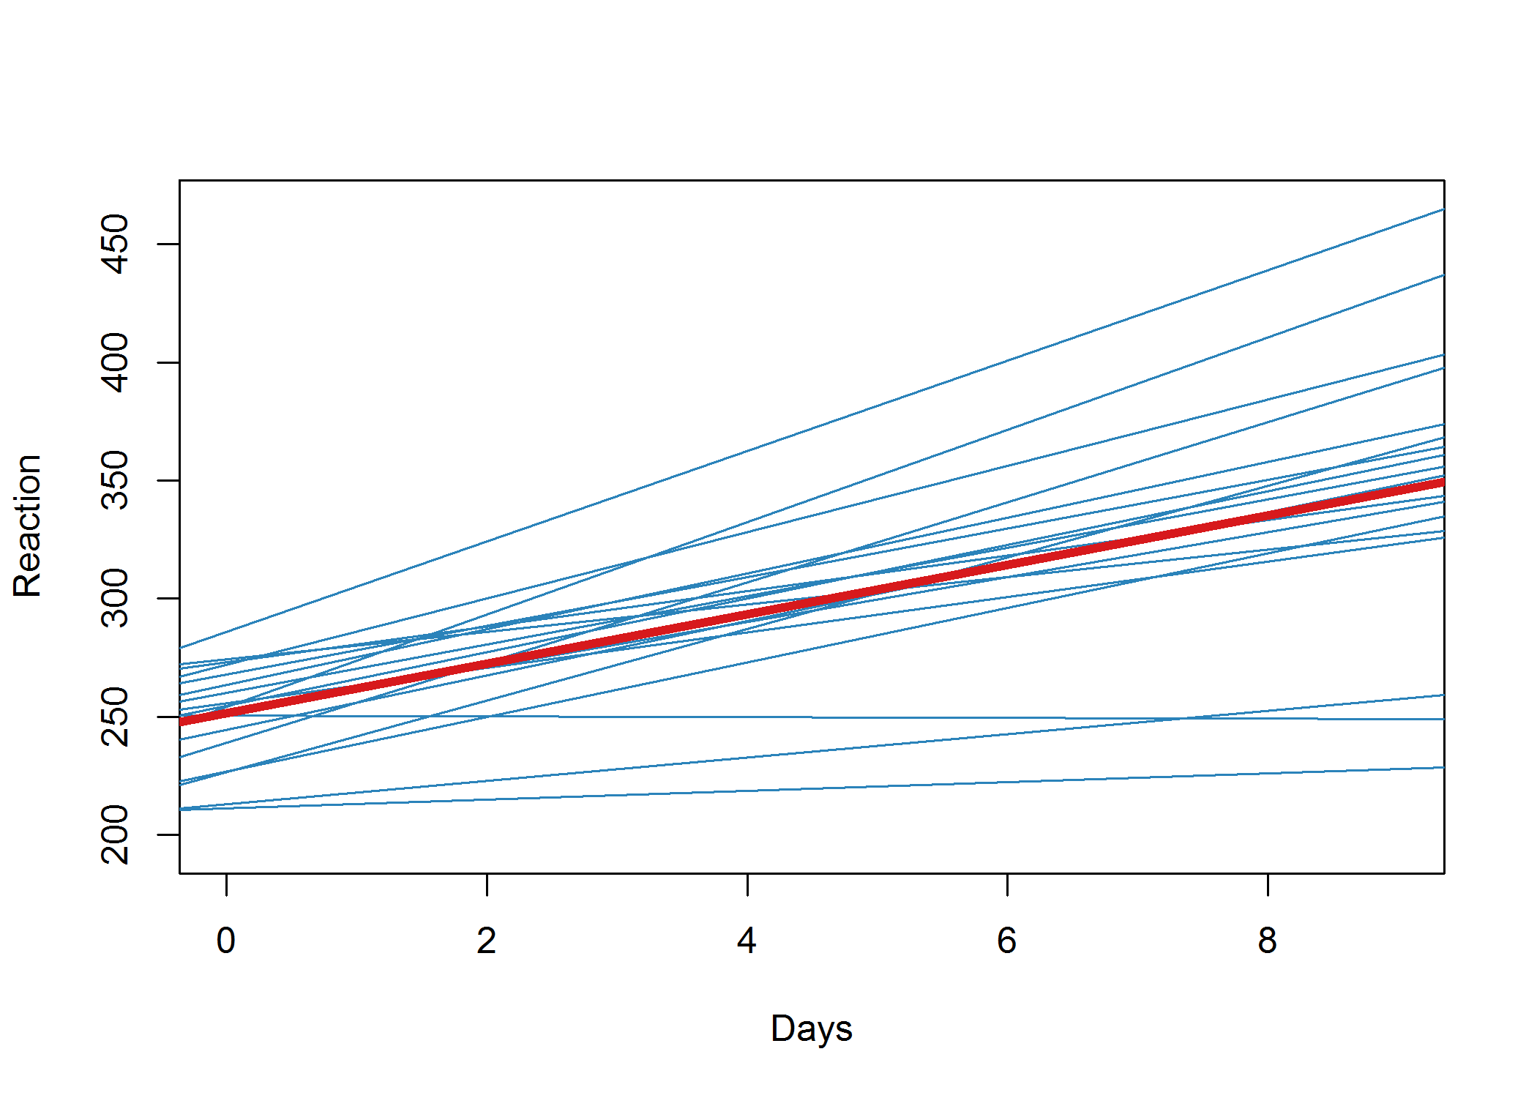
Better model

Slide 27
Now the slopes vary by participant too

Slide 29
Next step: R code!

Slide 30
Reaction ~ 1 + (1|Subject)

Slide 31
Reaction ~ 1 + Days + (1|Subject)

Slide 32
Reaction ~ 1 + Days + (1+Days|Subject)

Slide 33
What information do we get?
Random effects:
Groups Name Variance Std.Dev. Corr
Subject (Intercept) 612.09 24.740
Days 35.07 5.922 0.07
Residual 654.94 25.592
Number of obs: 180, groups: Subject, 18
Fixed effects:
Estimate Std. Error t value
(Intercept) 251.405 6.825 36.84
Days 10.467 1.546 6.77
Correlation of Fixed Effects:
(Intr)
Days -0.138

Slide 34
Gelman (2005)
‘We prefer to sidestep the overloaded terms “fixed” and “random” with a cleaner distinction […]. We define effects (or coefficients) in a multilevel model as constant [fixed] if they are identical for all groups in a population and varying [random] if they are allowed to differ from group to group.’
Gelman A. (2005). Analysis of variance— why it is more important than ever. Annals of Statistics, 33, 1–53

Slide 35
How to think about random effects
They are like residuals
(in fact residuals are random effects)
But they can be at higher levels in the dataset, e.g.,
slopes
intercept
by school, class, participant, …

Slide 36
Random effects: tells you about the variation at different levels
Random effects:
Groups Name Variance Std.Dev. Corr
Subject (Intercept) 612.09 24.740
Days 35.07 5.922 0.07
Residual 654.94 25.592
Number of obs: 180, groups: Subject, 18

Slide 37
Fixed effects – interpret as for regression: mean change
Estimate Std. Error t value
(Intercept) 251.405 6.825 36.84
Days 10.467 1.546 6.77
Correlation of Fixed Effects:
(Intr)
Days -0.138

Slide 38
Interactive entertainment
Read in the sleepstudy.csv dataset
Make the “Subject” variable a factor
Try the following library(lattice) xyplot(Reaction ~ Days | Subject, data = dat)

Slide 39
More entertainment
Use the lmer command to fit the models depicted in previous pictures:
Average intercept and allow the intercept to vary by Subject
Average intercept and average slope for Days; again allow the intercept to vary by Subject
Same as b, but additionally allow the slope for Days to vary by subject
What changes and what stays the same across the model summaries…?

Slide 40
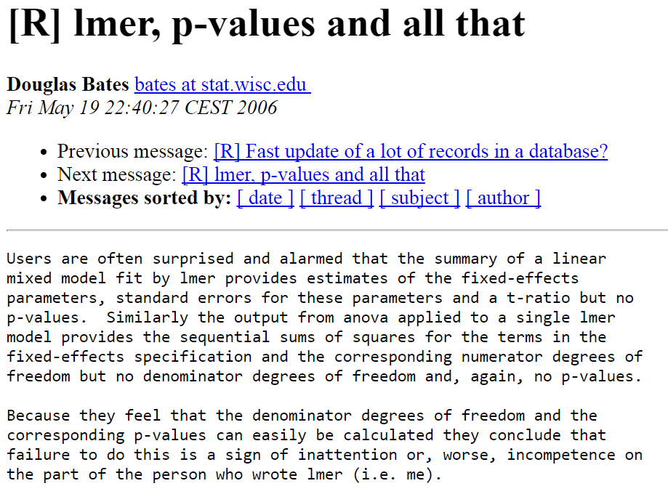

Slide 41
Solution 0
The anova command still works and gives you a log-likelihood ratio test with p-values
refitting model(s) with ML (instead of REML)
Data: dat
Models:
lmm0: Reaction ~ 1 + (1 | Subject)
lmm1: Reaction ~ Days + (1 | Subject)
Df AIC BIC logLik deviance Chisq Chi Df Pr(>Chisq)
lmm0 3 1916.5 1926.1 -955.27 1910.5
lmm1 4 1802.1 1814.8 -897.04 1794.1 116.46 1 < 2.2e-16 ***
Write this as: χ²(1) = 116.4, p < .001

Slide 42
Solution 1
Use confidence intervals instead. These do work for lmer!
confint(model name, oldNames = FALSE)
Try with and without the oldNames option to see what that does
Remember this command also works for lm and glm and polr

Slide 43
Solution 2
Use Alexandra Kuznetsova et al.’s
lmerTest package
This fixes the standard summary command so it includes an approximate p-value. So just do:
library(lmerTest)
mod <- lmer(...)
summary(mod)

Slide 44
You can allow the intercept and slopes to vary at multiple levels…
lmer(outcome ~ 1 + (1|ID) + (1|Classroom) …)
Intercept varies by ID and by classroom
lmer(outcome ~ 1 + Days + (1 + Days | ID) + (1 + Days | Classroom) …)
Intercept and slope for Days varies by ID and classroom

Slide 45

Diagnostics

Slide 46
Linear regression assumptions (Gelman & Hill, 2007, pp.45-46)
Validity. The data map to the research question
Additivity and linearity y = B₀ + B₁x₁ + B₂x₂ + … (Transforming the xs and y might help, if not)
Independence of errors
Equal variance of errors (“Homoscedasticity”)
Normal distribution of errors

Slide 47
Linear multilevel regression assumptions
Validity. The data map to the research question
Additivity and linearity y = B₀ + B₁x₁ + B₂x₂ + … Transforming the xs and y might help, if not
Independence of errors We have a new trick for dealing with dependence
Equal variance of errors (“Homoscedasticity”)
Normal distribution of errors
Now also have higher level “errors”:
random slopes & intercepts

Slide 48
What’s the same?
VIFs – as before (use vif in the car package)
Get the residuals and predicted values as before:
resid (mod)
predict(mod)
These commands give numbers, which can be scatter plotted (to check for homogeneity of variance) and histogrammed (to check for normal distributed residuals)
Where mod is your model’s name

Slide 49
The random effects (here just for Subject; you could have more, e.g., for schools or teachers)
> ranef(myMod)
$Subject
(Intercept) Days
308 2.2585654 9.1989719
309 -40.3985769 -8.6197032
310 -38.9602458 -5.4488799
330 23.6904985 -4.8143313
331 22.2602027 -3.0698946
332 9.0395259 -0.2721707 …

Slide 50
Select the subject ones
> ranef(myMod)$Subject
(Intercept) Days
308 2.2585654 9.1989719
309 -40.3985769 -8.6197032
310 -38.9602458 -5.4488799
330 23.6904985 -4.8143313
331 22.2602027 -3.0698946
332 9.0395259 -0.2721707 …

Slide 51

The parentheses in “(Intercept)” confuse R, so you need to use backquotes:
> ranef(myMod)$Subject$`(Intercept)`
2.2585654 -40.3985769 -38.9602458 23.6904985 22.2602027 9.0395259 16.8404311 -7.2325792 -0.3336958 34.8903508 -25.2101104 …

Slide 52
Alternatively, ask for the first column
> ranef(myMod)$Subject[,1]
2.2585654 -40.3985769 -38.9602458 23.6904985 22.2602027 9.0395259 16.8404311 -7.2325792 -0.3336958 34.8903508 -25.2101104 …

Slide 53
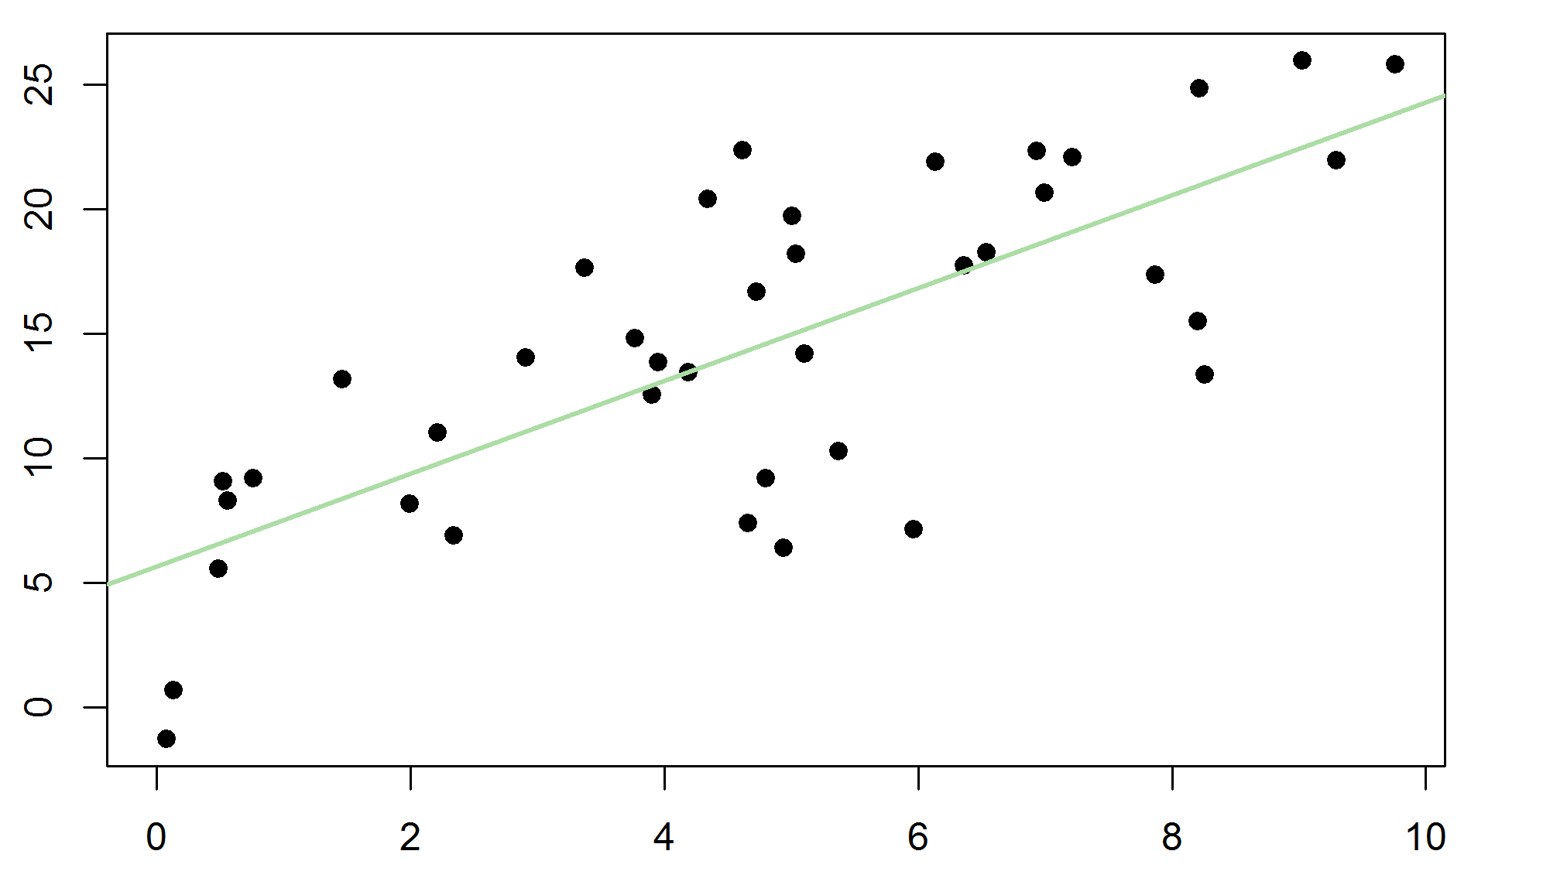
Summary
Multilevel models are
extensions of regression
Allow multilevel data, like students in classrooms (in schools (in counties (in countries)))…
Describing
variation at different levels
+ average relationships

Slide 54
The end

